Slide 1


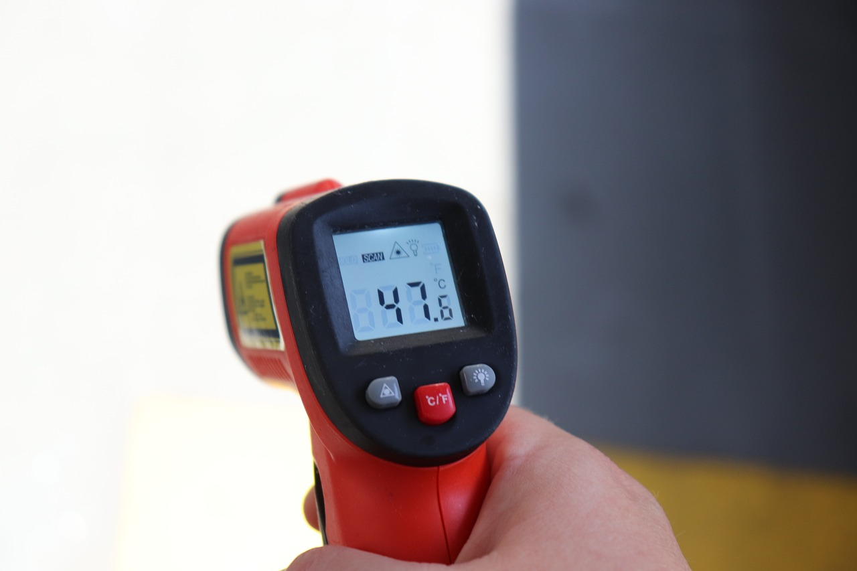
Problem solving with integers and decimals
Task A: Integers, negatives and decimals in the real world
Aisha has £13.45 credit on her school account. She spends £2.67 then spends £7.89. Aisha then puts £4.21 back into her account.
How much does Aisha have in her school account now?
13.45 − 2.67 − 7.89 + 4.21 =
13.45 + (-2.67) + (-7.89) + 4.21 =
17.66 + (-10.56) = 7.1
Aisha has £7.10 left.
2) Jun has a £20 note. He buys 4 green pens, 6 pencils and 2 orange highlighters.
The shopkeeper gave Jun £6.16 in change.
Is this correct? Show your working out.
4 × 1.56 = 2 × 2 × 1.56 = 2 × 3.12 = 6.24
£1.56
76p
£1.27
6 × 0.76 = 3 × 0.76 × 2 = 2.28 × 2 = 4.56
2 × 1.27 = 2.54
6.24 + 4.56 + 2.54 = 13.34
20 - 13.34 = 6.66
The change is incorrect. Jun should get £6.66
3) There are two places in Antarctica scientists want to investigate. They look at the temperature in the morning over 5 days.
Location 1 | −24.3℃ | −21.6℃ | −20.9℃ | −24.15℃ | −24.8℃
(−24.3) + (−21.6) + (−20.9) + (−24.15) + (−24.8) = (−115.75)
(−115.75) ÷ 5 = (−115.75) ÷ 10 × 2 = (−11.575) × 2 = (−23.15)
Location 2 | −22℃ | −21℃ | −26℃ | −24℃ | −24.8℃
(−22) + (−21) + (−26) + (−24) + (−24.8) = (−117.8)
(−117.8) ÷ 5 = (−117.8) ÷ 10 × 2 = (−11.78) × 2 = (−23.56)
Location 2 is slightly colder on average than location 1.

Slide 2

Problem solving with integers and decimals
4) Andeep is taking part in a local Maths competition.
There are 10 questions.
Each correct answer gets 8 points.
Each incorrect answer gets (-6) points.
Each question not answered gets (-2) points.
a) Andeep answers 4 correct, 3 incorrect and misses 2 questions. How many points does he have?
4 × 8 + 3 × (-6) + 2 × (-2) =
32 + (-18) + (-4) =
Andeep has 10 points
32 + (-22) = 10
4b) In a different competition, Lucas gets 36 points.
There are 8 questions.
Each correct answer gets 12 points.
Each incorrect answer gets (-4) points.
Each question not answered gets (-2) points.
Give some examples of how Lucas performed in the competition.
Example
4 × 12 + 2 × (-4) + 2 × (-2) = 36
4 correct, 2 incorrect and 2 missed

Slide 3



Problem solving with integers and decimals
Task B: Measurements and accuracy
1) Here is an example of two car rental companies.
Rent-a-Red-car
0.46 × 70 =
4.6 × 7 =
32.20
Rent-a-Blue-car
Rent-a-Red-Car
1 km = £0.46
2500 m = 2.5 km
Rent-a-Blue-Car
2500 m = £1.10
70 ÷ 2.5 =
700 ÷ 25 =
28
28 × 1.1 =
28 × 11 × 0.1 =
30.8
£32.20 - £30.80 = £1.40
An Oak teacher knows he will need to rent a car for a 70 km journey. Work out the difference in prices between the two companies for a 70 km car hire.
2) Sofia helps her neighbour feed her cats using a feeding chart.
Mass to the nearest 10 g | Quantity of dry food per day
🐱 1 - 2.99 kg | 70 g
🐱 3 kg - 4.99 kg | 90 g
🐱 5 - 5.99 kg | 100 g
🐱 more than 6 kg | 115 g
1.5 kg of dry food
£9.82
Her neighbour has three cats weighing 4.5 kg, 5.1 kg and 6.2 kg.
How much will it cost to feed all three cats for 2 weeks?
4.5 kg cat requires 90 g per day
5.1 kg cat requires 100 g per day
6.2 kg cat requires 115 g per day
Total food per day is 90 + 100 + 115 = 305 g per day
For 2 weeks it is 305 × 14 = 4 270g
1.5 kg = 1500 g
She will need 3 bags.
9.82 × 3 = £29.46 needs to be spent on cat food.
Mathematics in Education and Industry
v2.2

